Slide 1

DEPARTMENT OF
COMPUTER SCIENCE & ENGINEERING
DATA ANALYTICS (23CST-613)
M.E. – 1st SEMESTER
COURSE COORDINATOR: DR. MANJIT SINGH

Slide 2
Data warehousing Architecture
Department Name
Scholar Name

Slide 3
Objectives
Define terms
Explore reasons for information gap between information needs and availability
Understand reasons for need of data warehousing
Describe three levels of data warehouse architectures
Describe two components of star schema
Estimate fact table size
Design a data mart
Develop requirements for a data mart
Department Name
Scholar Name

Slide 4
Definitions
Data Warehouse
  A subject-oriented, integrated, time-variant, non-updatable collection of data used in support of management decision-making processes
    Subject-oriented: e.g. customers, patients, students, products
    Integrated: consistent naming conventions, formats, encoding structures; from multiple data sources
    Time-variant: can study trends and changes
    Non-updatable: read-only, periodically refreshed
Data Mart
  A data warehouse that is limited in scope
Department Name
Scholar Name

Slide 5
History Leading to Data Warehousing
Improvement in database technologies, especially relational DBMSs
Advances in computer hardware, including mass storage and parallel architectures
Emergence of end-user computing with powerful interfaces and tools
Advances in middleware, enabling heterogeneous database connectivity
Recognition of difference between operational and informational systems
Department Name
Scholar Name

Slide 6
Need for Data Warehousing
Integrated, company-wide view of high-quality information (from disparate databases)
Separation of operational and informational systems and data (for improved performance)
Department Name
Scholar Name

Slide 7
Data Warehouse Architectures
Independent Data Mart
Dependent Data Mart and Operational Data Store
Logical Data Mart and Real-Time Data Warehouse
Three-Layer architecture
All involve some form of extract, transform and load (ETL)
Department Name
Scholar Name

Slide 8
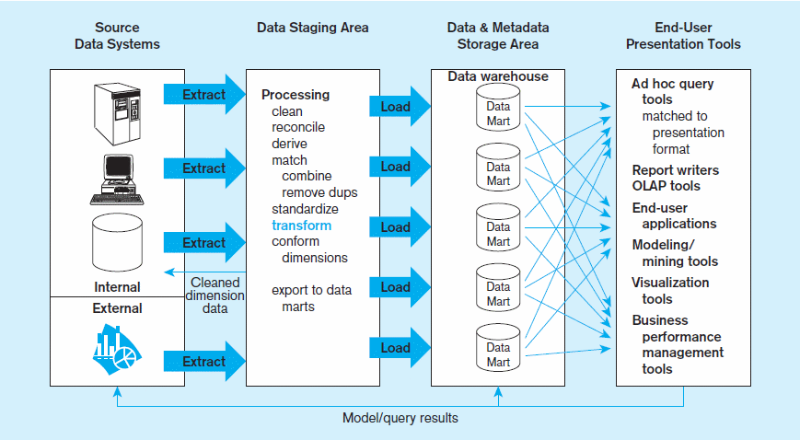
Figure 9-2 Independent data mart data warehousing architecture
Data marts:
Mini-warehouses, limited in scope
L
T
E
Separate ETL for each independent data mart
Data access complexity due to multiple data marts
Chapter 9
Department Name
Scholar Name

Slide 9
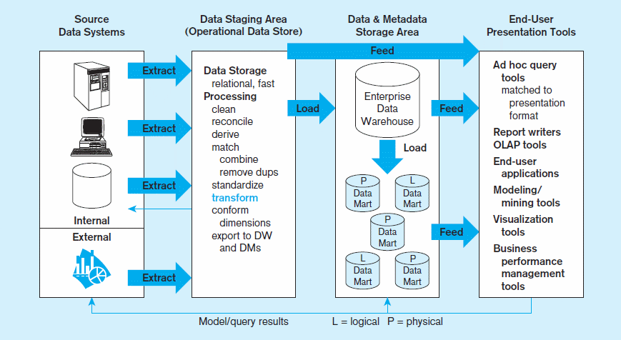
Figure 9-3 Dependent data mart with operational data store: a three-level architecture
ODS provides option for obtaining current data
L
T
E
Simpler data access
Single ETL for
enterprise data warehouse (EDW)
Dependent data marts loaded from EDW
Chapter 9
Copyright © 2014 Pearson Education, Inc.
Department Name
Scholar Name

Slide 10
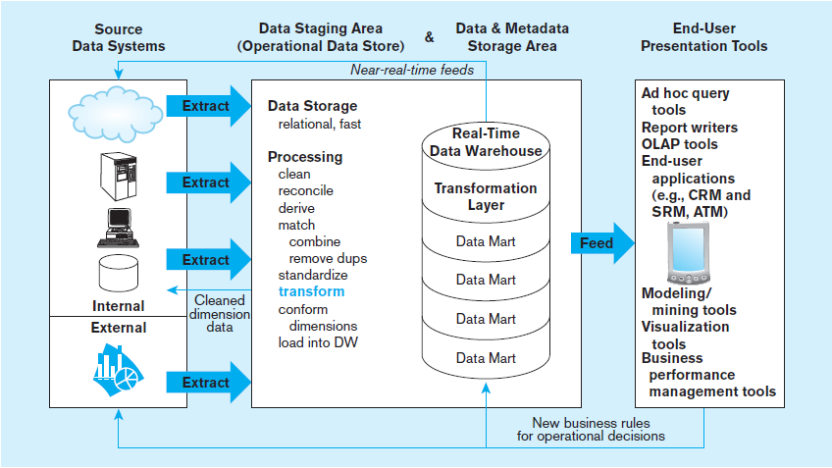
Figure 9-4 Logical data mart and real time warehouse architecture
ODS and data warehouse are one and the same
L
T
E
Near real-time ETL for
Data Warehouse
Data marts are NOT separate databases, but logical views of the data warehouse
➔ Easier to create new data marts
Chapter 9
Copyright © 2014 Pearson Education, Inc.
Department Name
Scholar Name

Slide 11
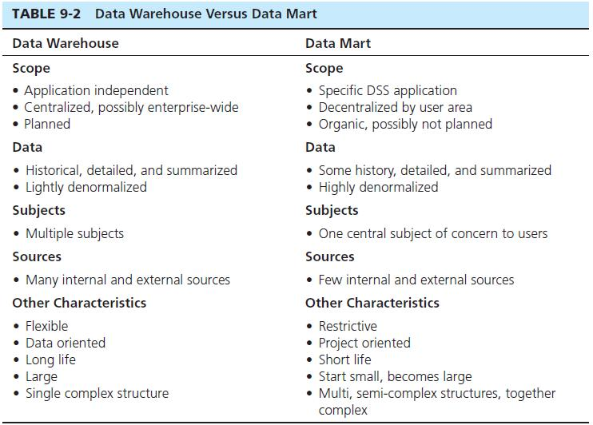
Chapter 9
Copyright © 2014 Pearson Education, Inc.
Department Name
Scholar Name

Slide 12
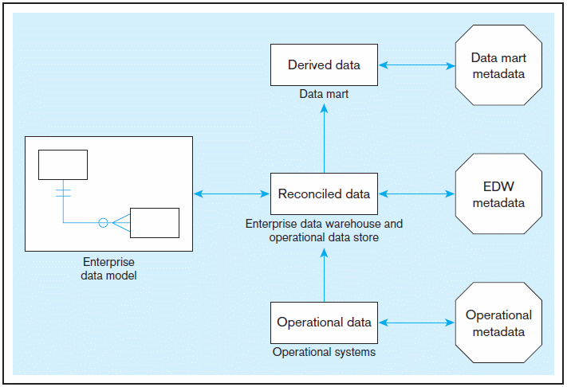
Figure 9-5 Three-layer data architecture for a data warehouse
Chapter 9
Copyright © 2014 Pearson Education, Inc.
Department Name
Scholar Name

Slide 13
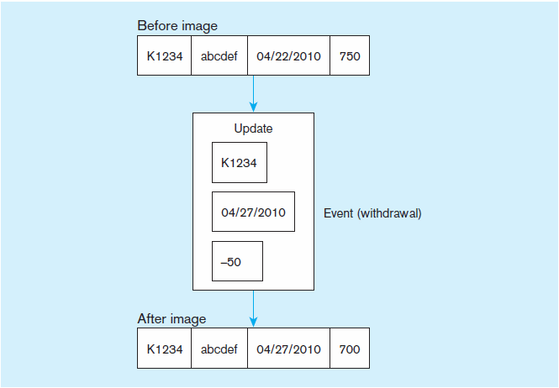
Data Characteristics
Status vs. Event Data
Figure 9-6 Example of DBMS log entry
Status
Event = a database action (create/ update/ delete) that results from a transaction
Status
Department Name
Scholar Name

Slide 14
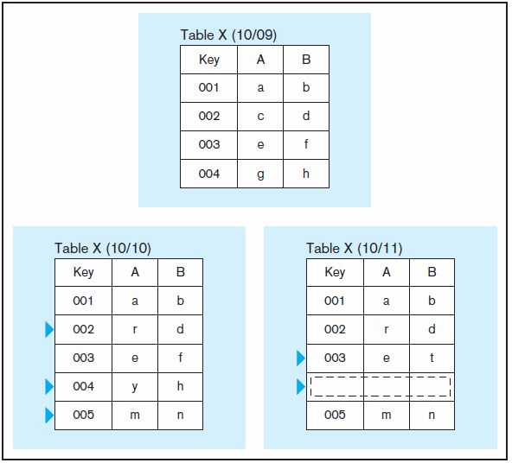
DATA CHARACTERISTICS
STATUS VS. EVENT DATA
Figure 9-7 Transient operational data
With transient data, changes to existing records are written over previous records, thus destroying the previous data content
Department Name
Scholar Name

Slide 15
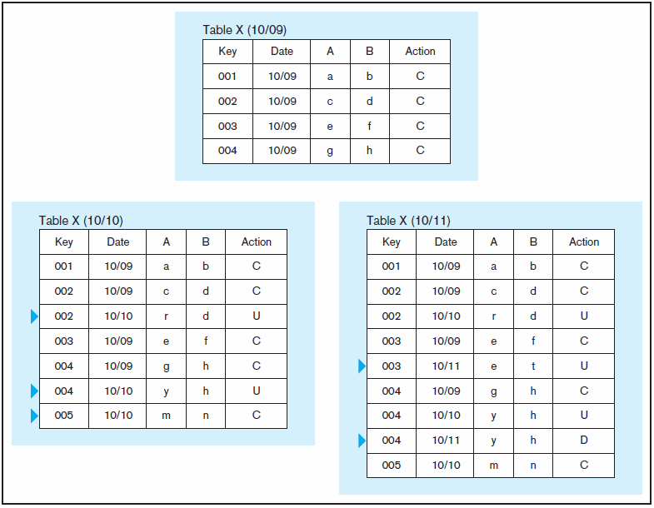
DATA CHARACTERISTICS
STATUS VS. EVENT DATA
Figure 9-8 Periodic warehouse data
Periodic data are never physically altered or deleted once they have been added to the store
Department Name
Scholar Name

Slide 16
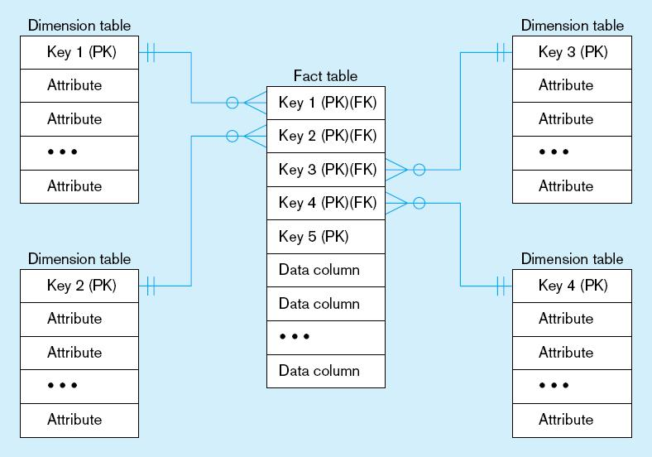
Figure 9-9 Components of a star schema
Fact tables contain factual or quantitative data
1:N relationship between dimension tables and fact tables
Dimension tables are denormalized to maximize performance
Dimension tables contain descriptions about the subjects of the business
Excellent for ad-hoc queries, but bad for online transaction processing
Chapter 9
Copyright © 2014 Pearson Education, Inc.
Department Name
Scholar Name

Slide 17
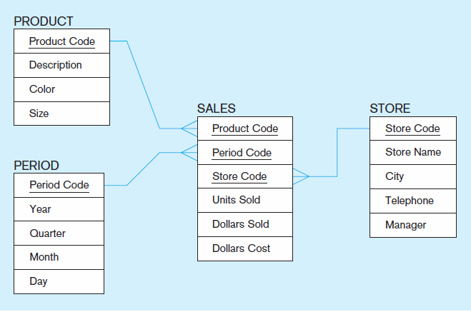
Figure 9-10 Star schema example
Fact table provides statistics for sales broken down by product, period and store dimensions
Chapter 9
Copyright © 2014 Pearson Education, Inc.
Department Name
Scholar Name

Slide 18
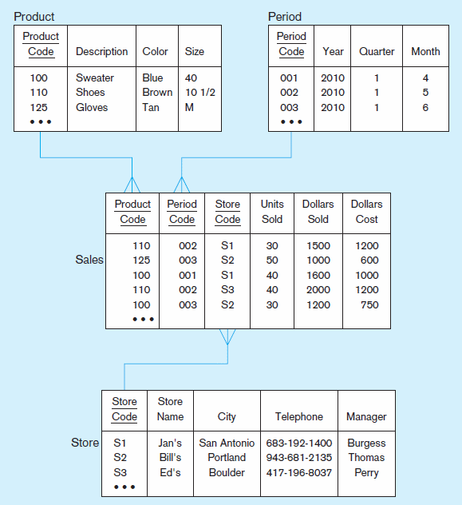
Figure 9-11 Star schema with sample data
Chapter 9
Copyright © 2014 Pearson Education, Inc.
Department Name
Scholar Name

